Slide 1
7 Top Tips – A full stack ASP.NET MVC5 EF6 Testable application
davemateer@gmail.com
Code and presentation on:
github.com/djhmateer/funny

Slide 2


Dave Mateer
Notes:
Dave Mateer – Brought up near Glasgow… lived in New Zealand for 8 years. Now live near Brighton… this isn’t Brighton
Degree is in Mechanical Engineering – worked offshore in Norway in oil business.
Worked as an outdoor instructor in UK, Sri Lanka and did Raleigh expeditions
Got into IT/Software in 1999 – 15 years.
Transitioned into a Dot Net developer since .NET2 days
Worked for small companies in UK, freelancer in Australia for 6 months, and NZ for 4 years..
Now I work for Quorum – Edinburgh based company. 40 people. 10 developers. Major clients are large financial institutions

Slide 3

Employees 40 Person company in Edinburgh Office in Brighton (3 people) Financial Services (banks)
Notes:
Enterprise Apps
Old technology
Hacked together by many many people
Crucial to the business
Throw hardware at solutions to get them to perform (perf usually an issue)
Business logic in SP’s
We come in and try to solve these issues
Over last 15 years I’ve found that most apps I develop are CRUDy – Create Read Update Delete

Slide 4
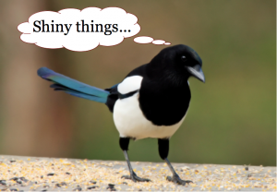
Notes:
Problems we solve at work are:
Complexity – Story about project with patterns..silverlight..comand pattern, many layerers of abstraction… no test.. Huge amounts of logic in SP’s
I used Integration testing (200 tests for SL front end) and a very simple service architecture. EF for most of the CRUDing, and sprocs for the bits which needed optimisation
2. Perfomance
The Plan
3 Separate solutions which we’ll review
7 Top tips along the way
Questions (please ask when you think of them)
Enterprise Apps
Old technology
Hacked together by many many people
Crucial to the business
Throw hardware at solutions to get them to perform (perf usually an issue)

Slide 5
Put your hand up if…
Notes:
Who is using ASP.NET MVC in a current work project?
Who has used it in the last 2 years for a work project
Who is here because they thought this session may have good jokes?

Slide 6
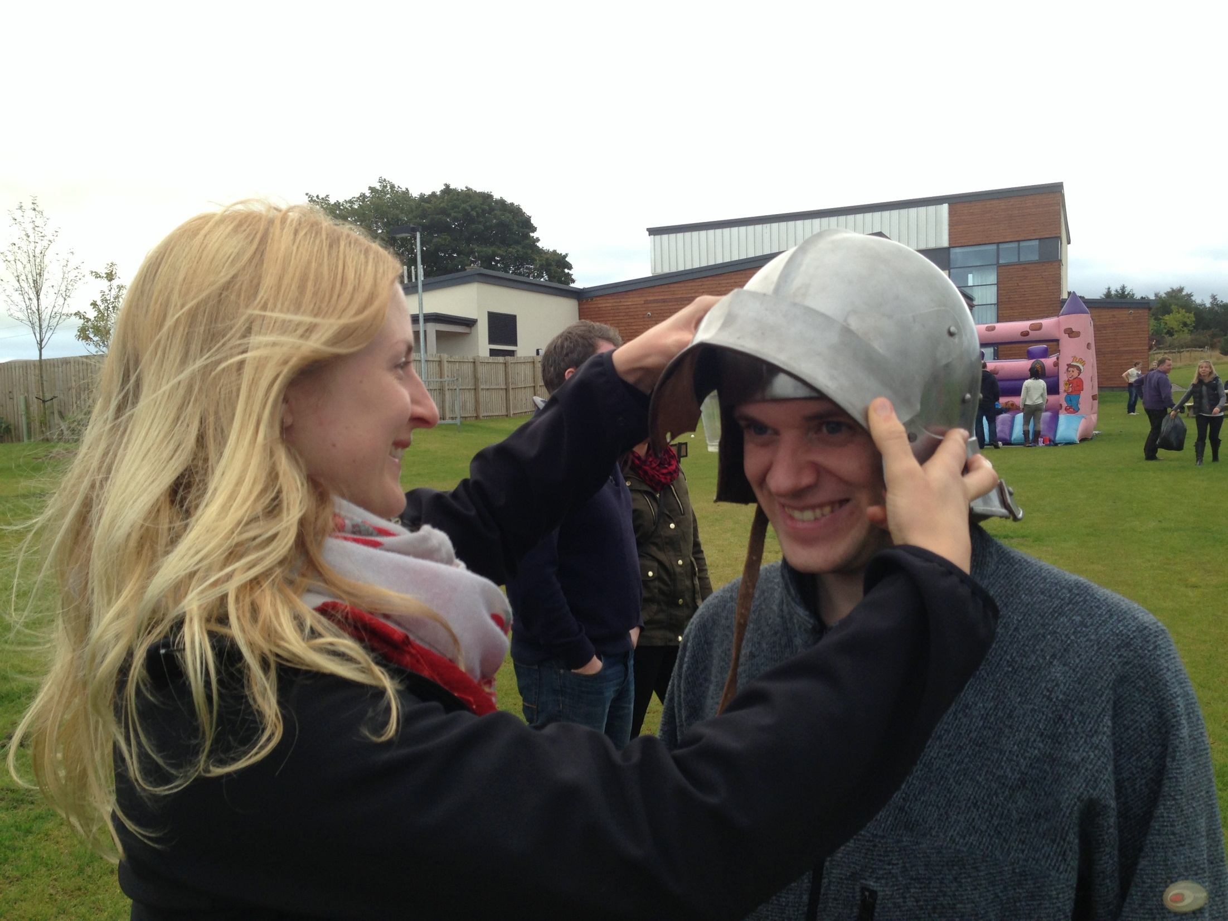
Notes:
Even if you’re a beginner swordsman, or an expert
Good News!!!
There is something here for everyone – the super experts, to the person who wants a new joke… we can always learn something from everyone.
Request – Please stop me if you’re confused, as someone else will be too.
Confession

Slide 7
CONFESSION

Slide 8
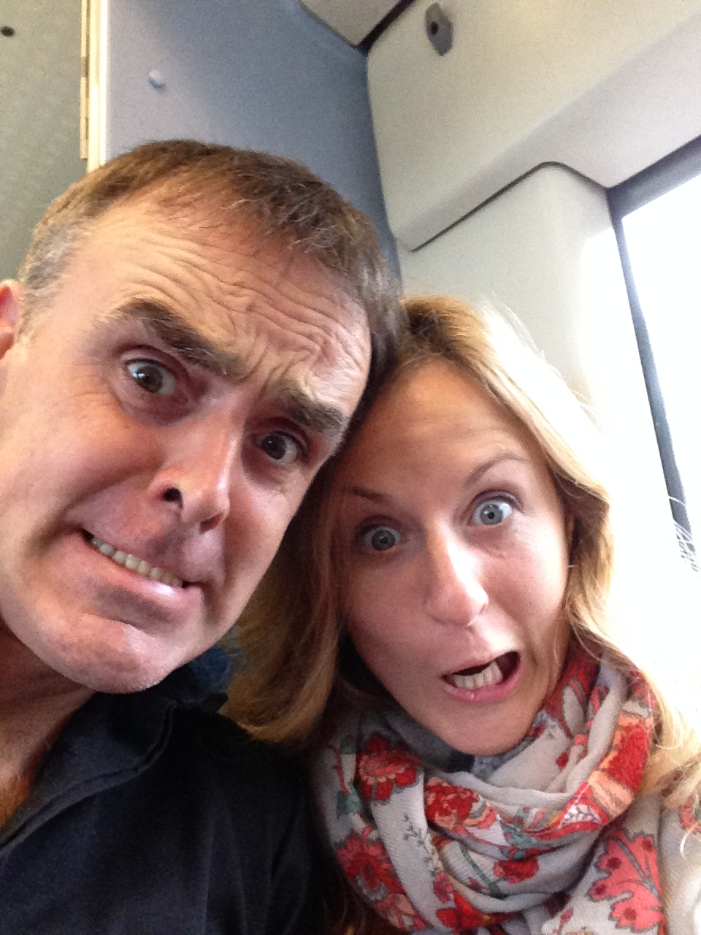
Notes:
Like being told bad jokes ☺

Slide 9
Q: What’s brown and sticky?

Slide 10
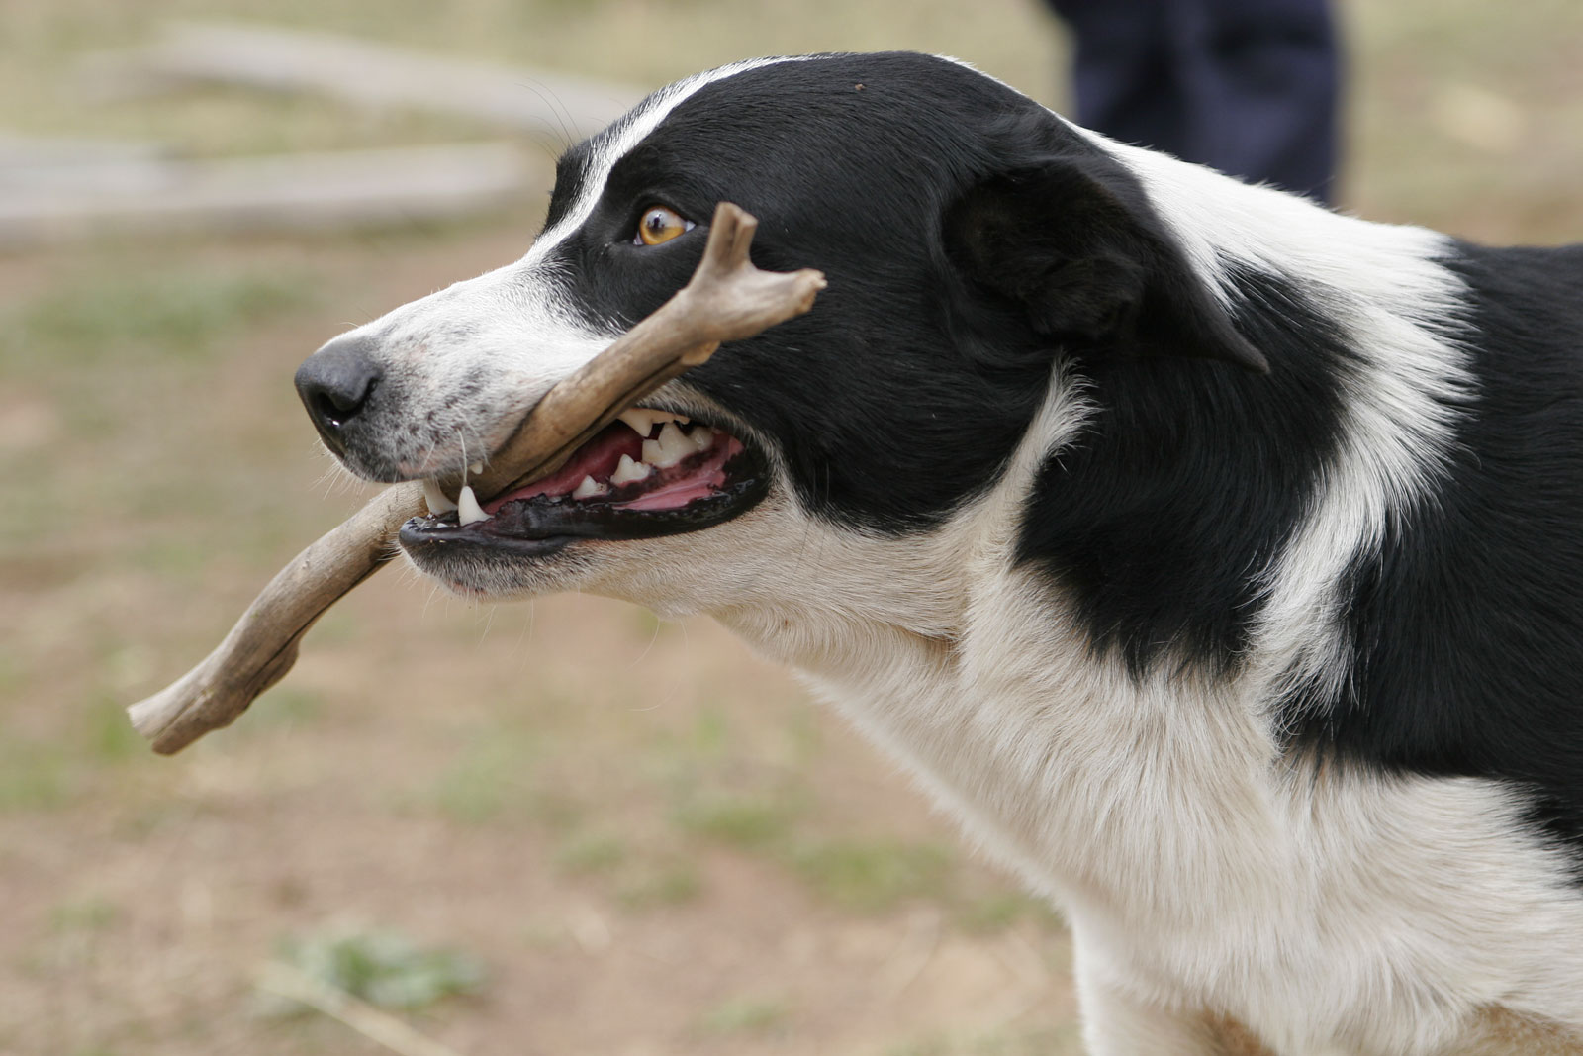
A stick….

Slide 11
File New Project..

Slide 12

Notes:
New MVC Project and solution called Dog
View website
Login as a user
View database

Slide 13
Tip 0 Source Control
Notes:
Add to git
Get it offsite onto github asap so can show it to friends at work or whatever
Bitbucket another alternative

Slide 14
Problem?
“Want to remember jokes when I’m out for dinner, so I can make people laugh”
Notes:
Like in developing business apps, I always write down the problem:
Ok that shouldn’t be too hard…
Slam a website together that works ok on my phone, in a weekend and it should be ok!
Hmm – maybe not.. Lets take this opportunity to play with code…
How about I call it Winter Project and spend a few months playing..
How about I model the project on what I do at work
Enterprisey
ASP.NET MVC (couldn’t get Nancy / Mono etc.. Into these classic institutions)
SQL Server (they’ve usually got it already)
Base it on my experience of what Enterprise apps need to be… ie
KISS
Development vs Maintenance costs.. Up to 80% of a projects costs are in maintenance
Overseas developers
Many developers jump in from 1 to 6 months to make small change
http://stackoverflow.com/questions/3477706/development-cost-versus-maintenance-cost

Slide 15
5 months of coding later… and 2 solutions thrown away..
Notes:
And this is the story of what I’ve learned…over the last 5 months..

Slide 16
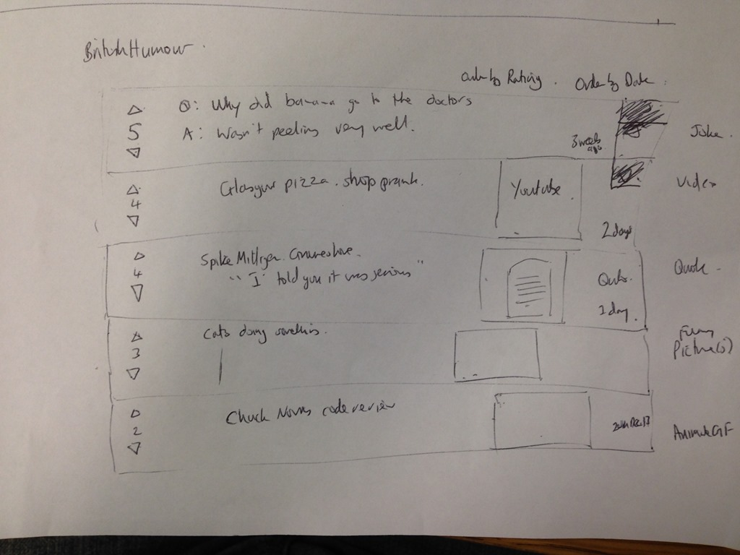
Notes:
http://www.programgood.net/default,page,7.aspx

Slide 17
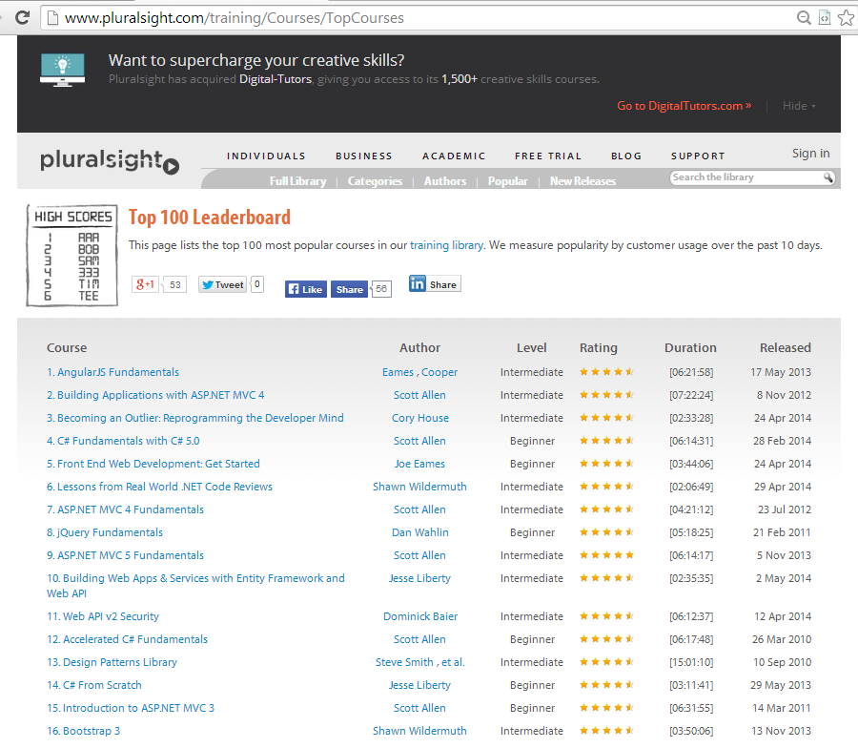
Notes:
Copy others
Pluralsight
Great MVC Sample code
Contoso University
http://www.asp.net/mvc/tutorials/getting-started-with-ef-using-mvc/creating-an-entity-framework-data-model-for-an-asp-net-mvc-application
SutekiShop
MVC3, Nhibernate, Windsor, Nunit, Rhino Mocks
K Scott Allen is a great educator!
ASP.NET MVC5 Fundamentals – 6 hours
Building Apps in MVC4 – 7 hours
ASP.NET MVC4 Fundamentals – 4 hours
Intro to MVC3 – 6 hours
nTier – Steve Smith
Testing – Jessie Liberty
DDD – Rob Conery
IoC http://pluralsight.com/training/Courses/Description/ioc-aspdotnet-mvc4
If you’re not a member, 200minutes free trial or look for giveaway tokens for a month.. Or get your work to pay for it recurringly £30 per month
So watched all of these, did lots of reading.. Took about 4 weeks to get something going…
and then Solution number 1 (winter)was like this:
MVC 5 – New Authorisation model
Seed method
Azure – website free (10 per person)
Glimpse
Caching
PagedList.Mvc
ELMAH (Error Logging Modules and Handlers)
BitBucket (good for private repos for free)
StructureMap
Repository Pattern

Slide 18
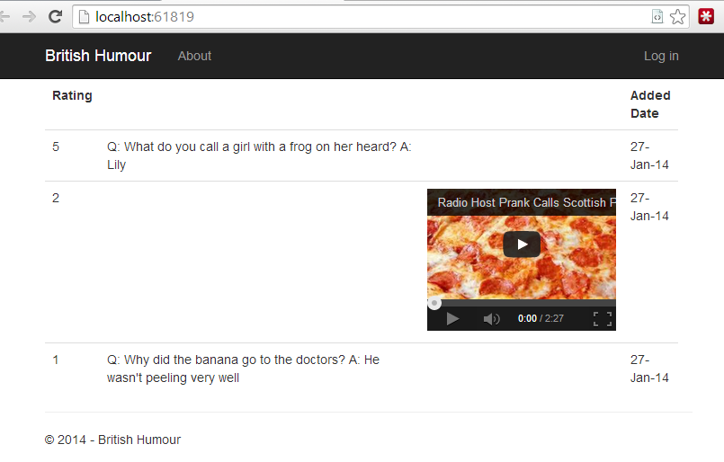
Solution 1 – Winter..TDD Style
Notes:
Inspired by Pluralsight videos and K Scott Allen
view
1break apart
controller
IRepository<T>
UoW
Repository
both
validation
test

Slide 19
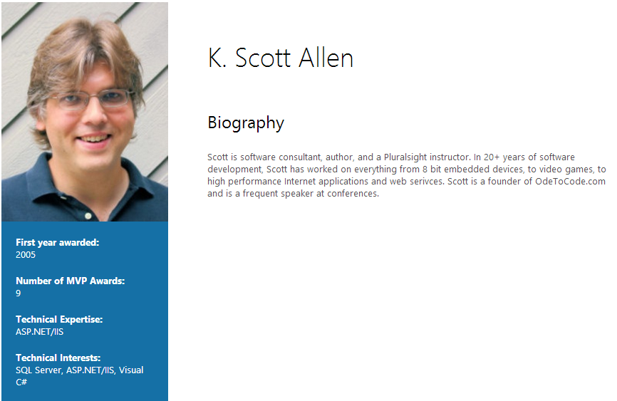
“I have found [testing] to be the most beneficial practice I have ever followed in my career”
Notes:
Standing on the shoulders of giants

Slide 20
Show project1 - winter
Notes:
Show code from Top
View
Controller
WinterDb (Irepo<T>)
Model – Story
Tests – StoryControllerTests..
given a valid story
given invalid story
TDD style – from point of view of what the application should do
Complexity – IoC..broken somewhere..

Slide 21
Diagram of Project on 1 slide

Slide 22
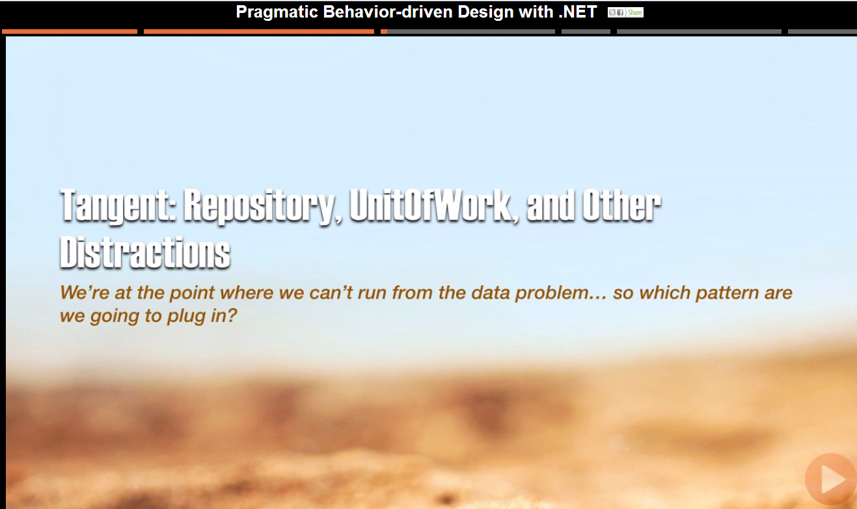
Notes:
Zeal and opinion is coming up!
- Rob Conery’s summary here

Slide 23
Unit Of Work
Create a “Context” or “Session”
Get objects from or add object to the session
Save the changes to the session transactionally when you are done

Slide 24
Repository
An object that contains explicity, transactional methods which return data or execute a command
Eg repo.GetUser(ID)
Notes:
CQRS – Udi Dahan and Greg Young
Separate queries and commands

Slide 25
Problems
UoW – single instance of a session with large app with many objects.. Single session early..ie on controller.
Repo – Spiralling methods.. Eg GetOrdersByCustomer, GetOrdersByCustomer

Slide 26
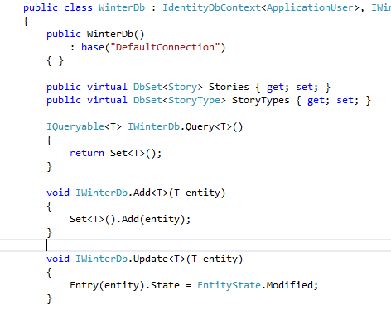
UoW and IRepository<T>
Defeats the purpose of both
Doubles abstraction
Notes:
Breaks idea of repository as works on a single class
Not transactional..repo methods should be atomic
- allows flush of UoW
Iqueryable so can tweak query with where clauses..breaks repo encapsulation
- extra layer of abstratcion

Slide 27
Review of Solution 1
Good
Bad
Simple(ish)
Didn’t feel Enterprisey
Wasn’t happy with validation
Do I need IoC yet?
Complexity for the sake of it..?
Why do I need IRepository<T>?
Broken encapsulation – controller too fat

Slide 28

Notes:
Have you heard the joke about the boomerang?
It’ll come back to you…

Slide 29
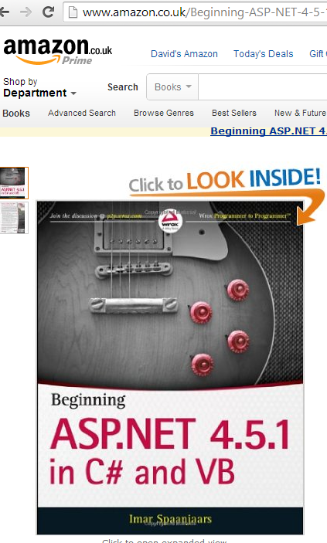

Solution 2 - nLayers
MVP Since 2008
Huge 10 part tutorial on an ‘enterprise app’
http://imar.spaanjaars.com/

Slide 30
Diagram here
Notes:
View Model
webgrid
html helpers
IoC - repo and UoW FActory
IQueryable
PagerModel abstraction
PeopleRepository
Repository base
Domain Entity and Value Objects
Validation
look in person

Slide 31
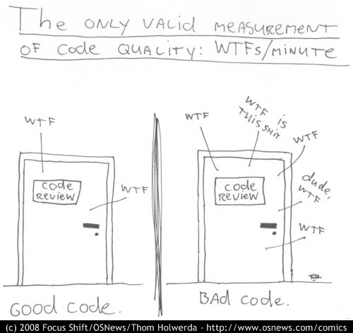

Slide 32
Review of nlayers
Good
Bad
Separation make easier for larger apps
Code reuse
Classic Unit Testability as mockable
Complex
Complex
Complex
Never made it to production
Notes:
Previous Versions
BLL/DAL – lots of pass through code
DAL tight coupling making hard to test
SP’s hard to maintain and test
Validation was custom – now have better ways

Slide 33
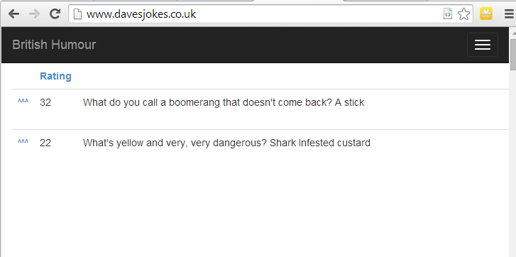
Project 3 - Funny
Please go to: www.davesjokes.co.uk
Notes:
Have a play – some good jokes on here ☺
Try to upvote – you may see some business logic!

Slide 34
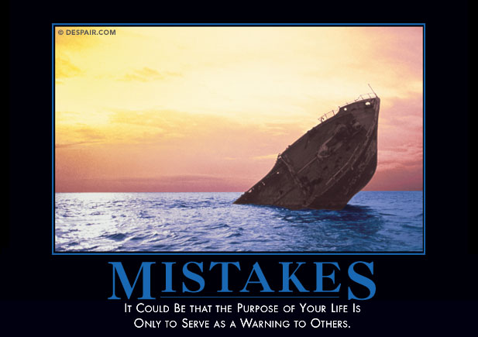
Notes:
Jokes
Images
Videos
Can upvote any of them

Slide 35
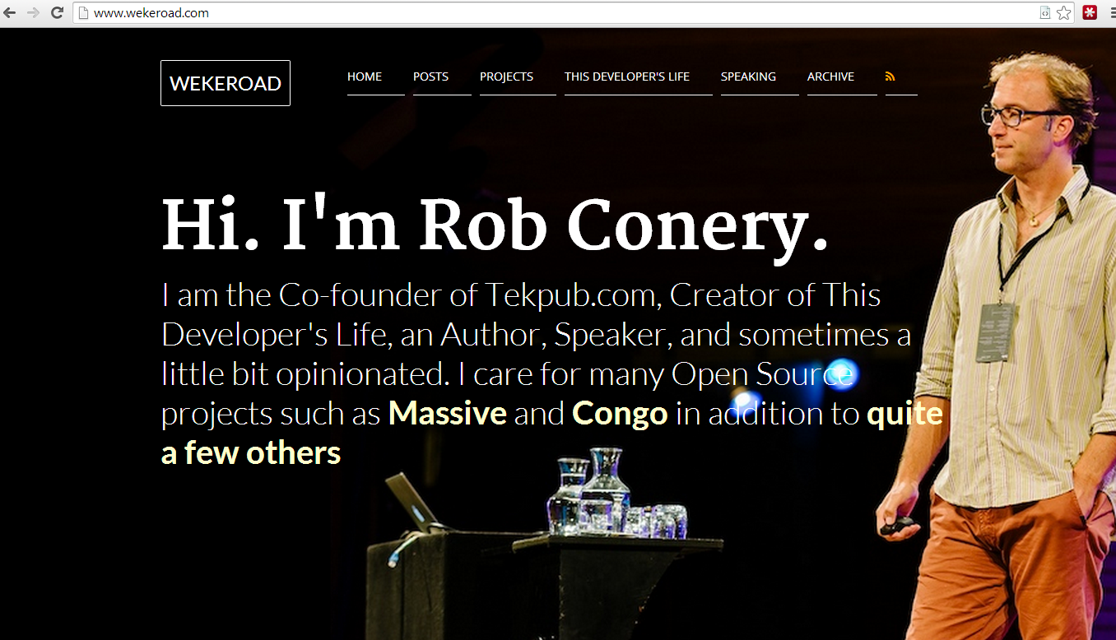

Slide 36
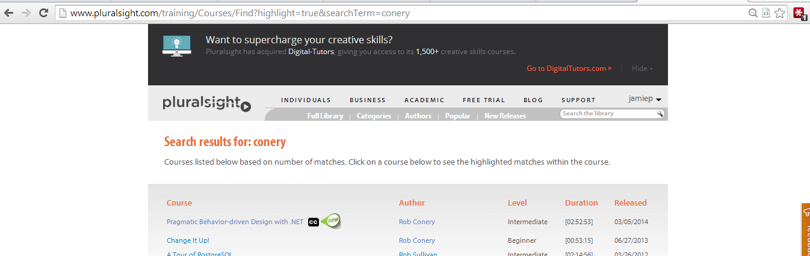
Notes:
Inspired by Rob Conery’s talk on BDD on pluralsight

Slide 37
Own Diagram here

Slide 38
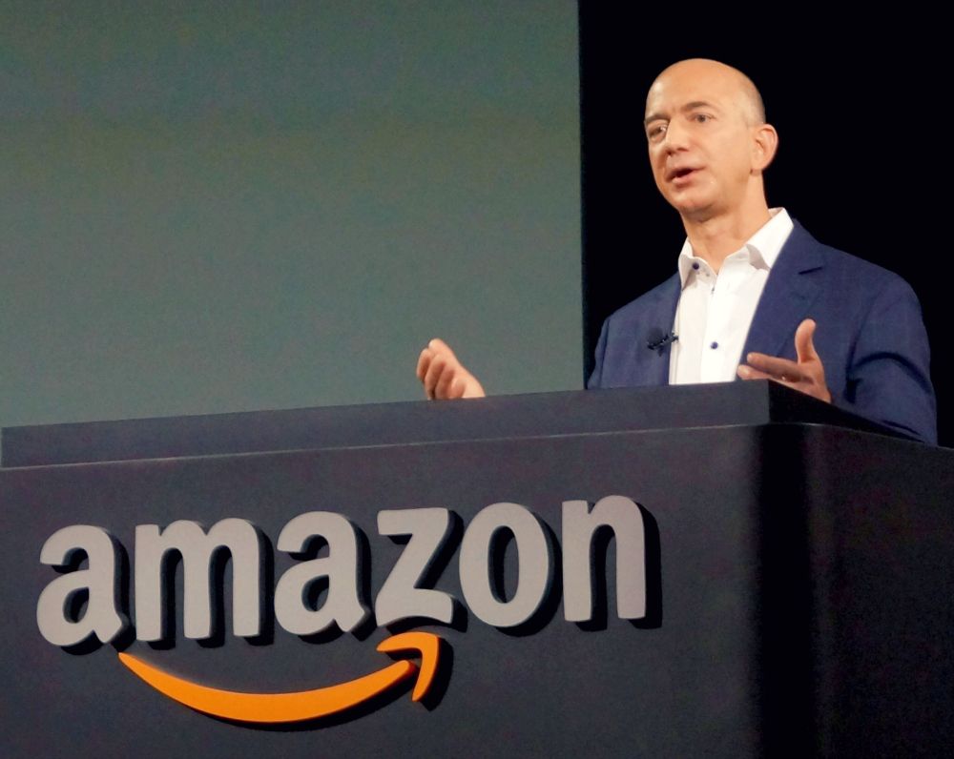
Notes:
Jeff Bezos – CEO of Amazon
“Start with the customer and work backwards”
Easy to remember URL
Show all Jokes on 1 page
Default to highest rating first
Can see most recently added Jokes
Be able to anonymously vote for a Joke
Be able to CRUD jokes as an admin
Easy maintainable system can hand over to another developer

Slide 39
Review of Project 3
Good
Bad
Simple
Tests are easy
Gave what the customer wanted fast
Slowdown of integration tests if not careful
UoW could get complex as app grows

Slide 40

Notes:
A blind man goes into a supermarket, picks his dog up, and swings it around his head. A passer by exclaims "What are you doing"????? The blind man says: Just looking around...

Slide 41
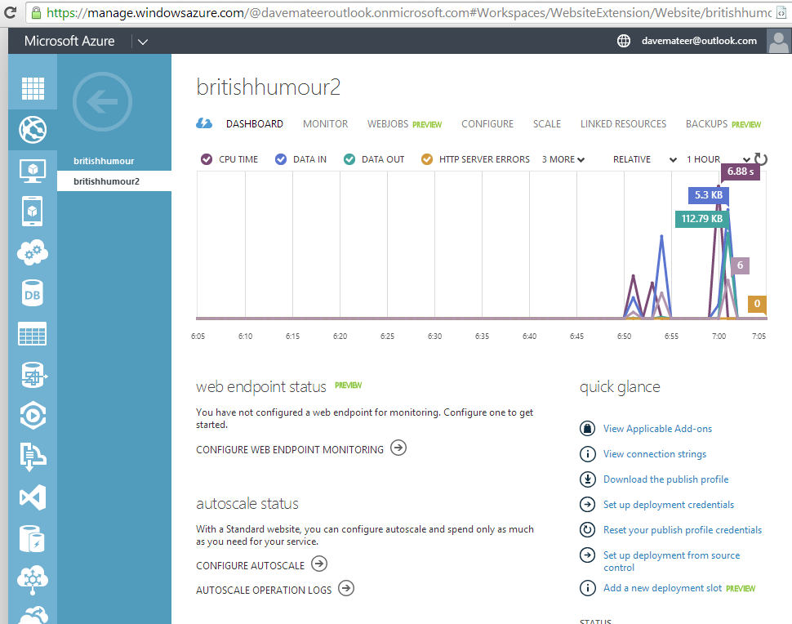
Tip 6 – Get working in production environment
Azure support in VS2013

Slide 42
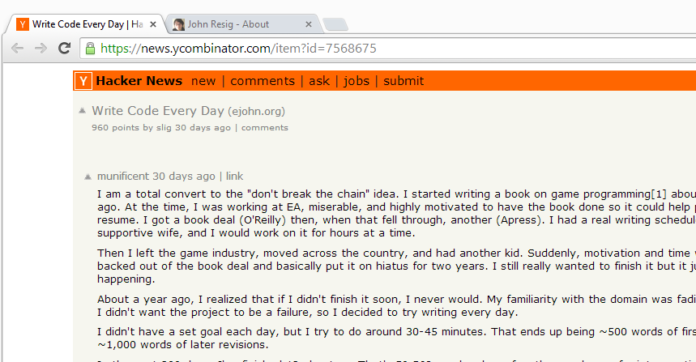

How?
Notes:
Enjoy Programming!!!
Ok but how…. I’m working in VB.NET on VS2005 for my day job, on a windows XP VM with 756MB of RAM…. Using ClearCase source control…???!!!!
John Resig – author of jQuery.. Hacker news…
Started getting up early… 5:45am seems okay for me. 6am-7:30am code
Take Ellie a cup of tea in bed!
Don’t check emails
Just try to code on your fun project

Slide 43
Coding every day..
Notes:
Last fall, work on my coding side projects came to a head: I wasn’t making adequate progress and I couldn’t find a way to get more done without sacrificing my ability to do effective work at Khan Academy.
There were a few major problems with how I was working on my side projects. I was primarily working on them during the weekends and sometimes in the evenings during the week. This is a strategy that does not work well for me, as it turns out. I was burdened with an incredible amount of stress to try and complete as much high quality work as possible during the weekend (and if I was unable to it felt like a failure). This was a problem as there’s no guarantee that every weekend will be free – nor that I’ll want to program all day for two days (removing any chance of relaxation or doing anything fun).
There’s also the issue that a week between working on some code is a long time, it’s very easy to forget what you were working on or what you left off on (even if you keep notes). Not to mention if you miss a weekend you end up with a two week gap as a result. That massive multi-week context switch can be deadly (I’ve had many side projects die due to attention starvation like that).
Inspired by the incredible work that Jennifer Dewalt completed last year, in which she taught herself programming by building 180 web sites in 180 days, I felt compelled to try a similar tactic: working on my side projects every single day.

Slide 44

Notes:
Sleep less
Can focus more at work
Less tired in evening

Slide 45
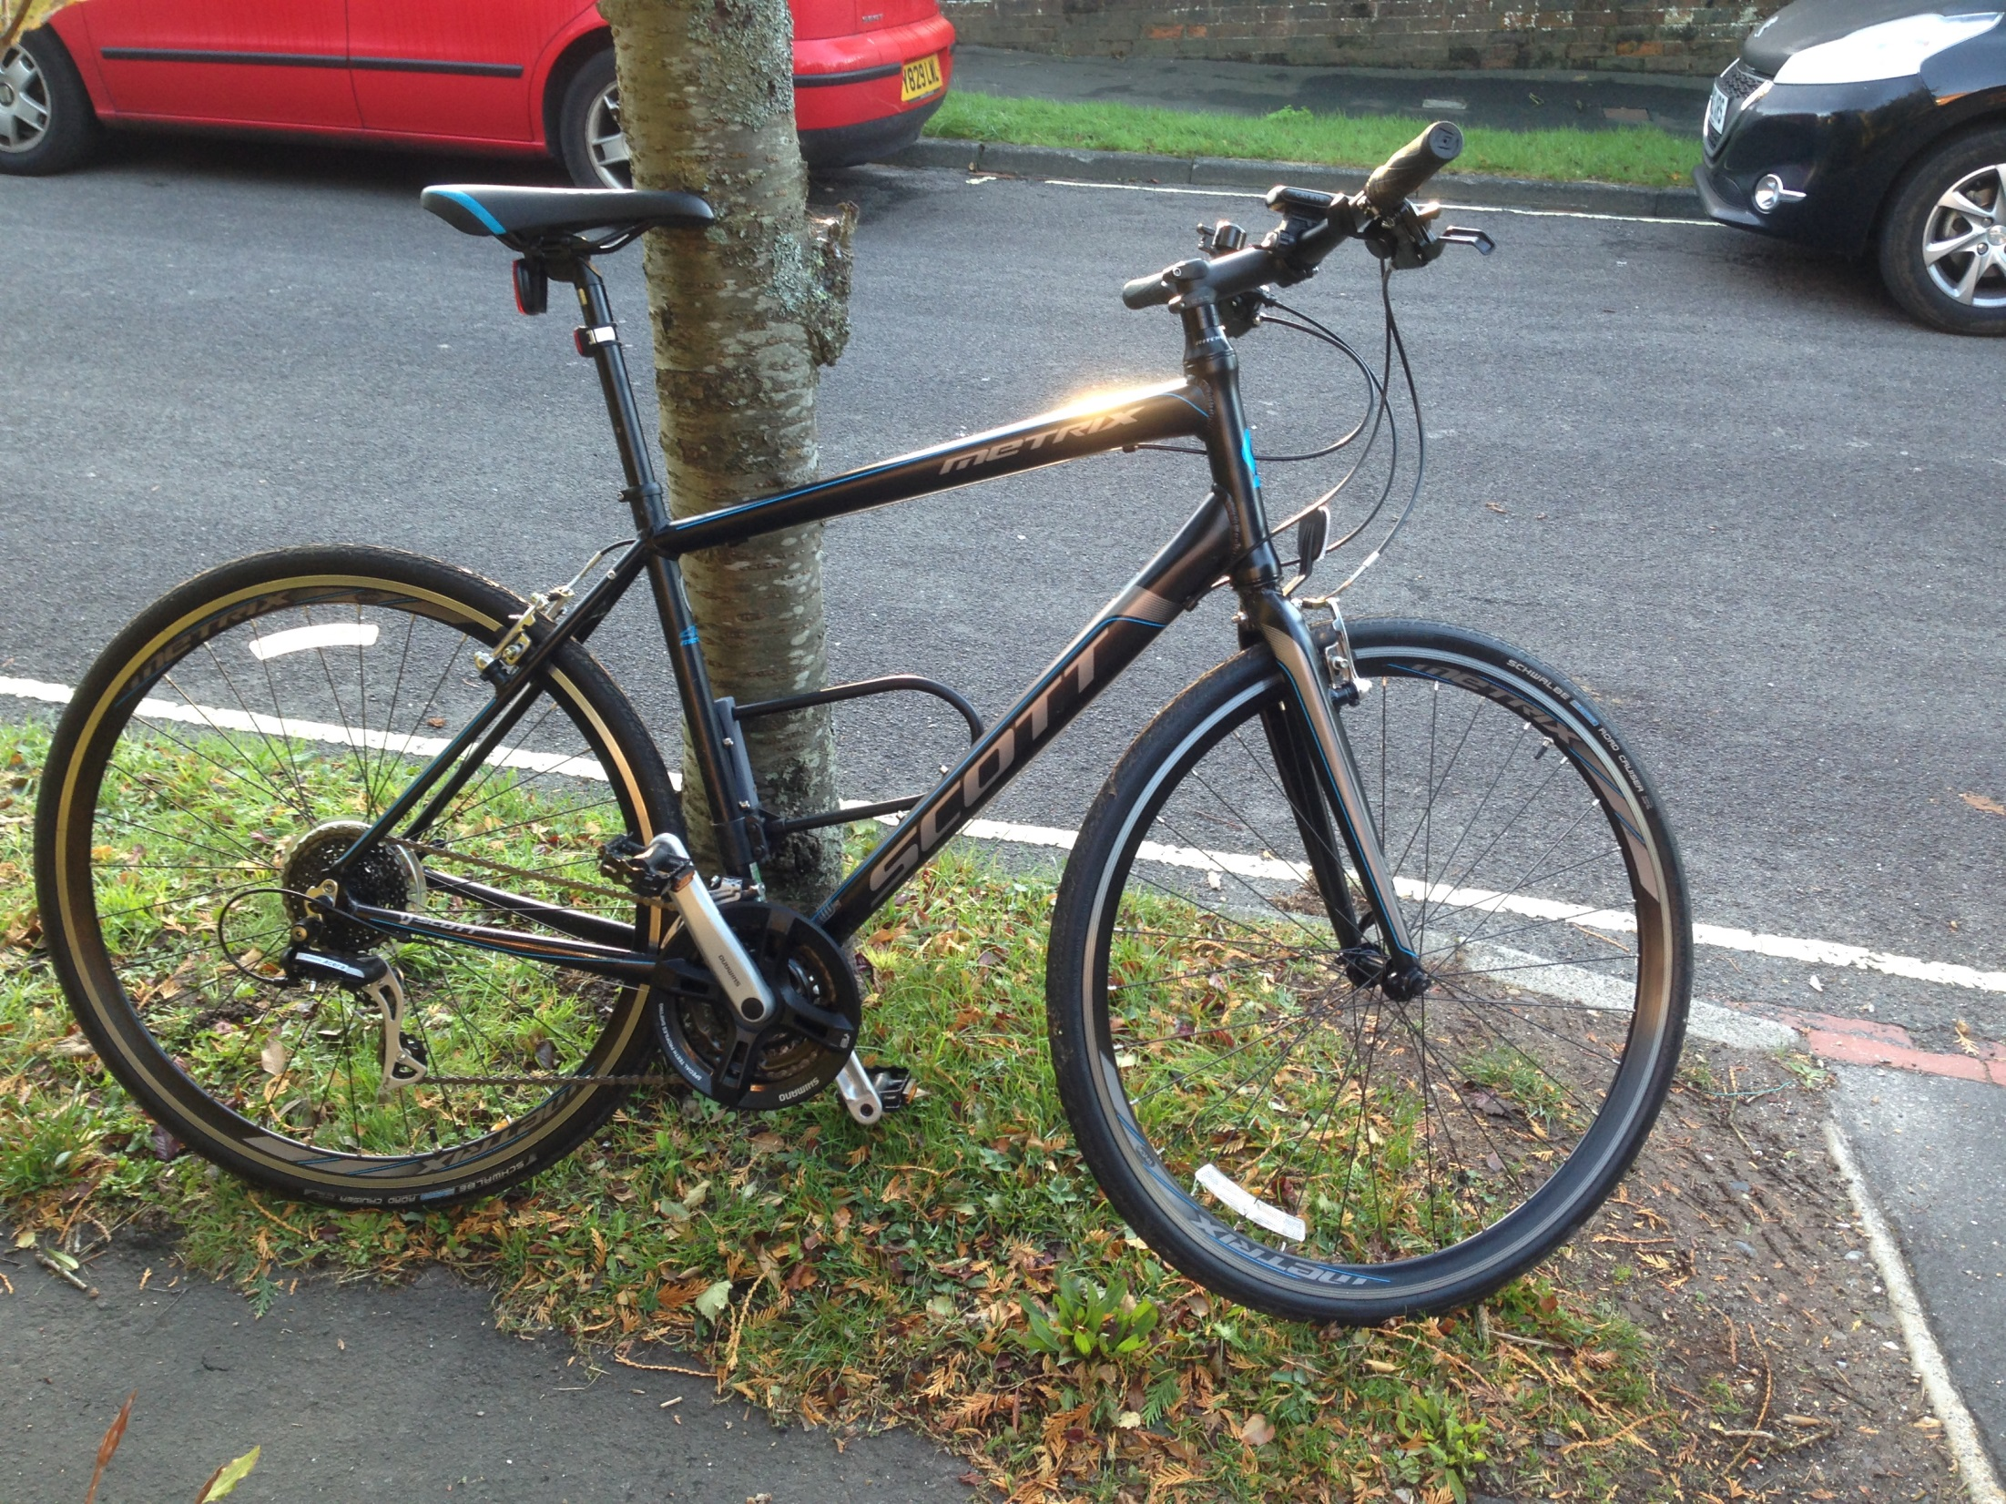
Notes:
Exercise – ride to work.. 35mins each way

Slide 46
0 – Source Control (Git)
1 – Start with customer ie tests (what you app does from customer point of view) and work backwards
7 – Azure support great.. Get app working end to end in production environement if possible (Azure)
2 – KISS (Keep it Simple).. IoC, UoW, ViewModels, AutoMapper needed??
3 – Composition over Inheritance
4 – Merge edit and create views
5 – Html ‘helpers’ – use html
6 – Enum support in 5.1

Slide 47

Thank you very much!
Enjoy programming ☺
Explore or code every day on something fun?
davemateer@gmail.com
(comments & jokes too!)
github.com/djhmateer/funny
www.davesjokes.co.uk

